Slide 1
Customer Segmentation using Clustering
By
Divyabharathi S.

Slide 2
Business Problem
Retail businesses need a deeper understanding of customer behavior to create personalized marketing strategies.
The goal is to segment customers based on spending patterns and income levels, enabling businesses to improve customer experience, optimize marketing efforts, and boost sales.

Slide 3
Current Solution & Challenges
Challenges with Traditional Approaches:
Generic Marketing Strategies: One-size-fits-all campaigns lack effectiveness and lead to lower conversion rates.
Manual Segmentation: Using age or gender alone for segmentation lacks precision and overlooks key behavioral patterns.
Need for Data-Driven Insights: Businesses require data-backed segmentation to create effective promotions and targeted outreach.

Slide 4
Proposed Solution
Leveraging Unsupervised Learning for Customer Segmentation
Using clustering techniques in machine learning, we can segment customers into different groups based on:
Annual Income (k$)
Spending Score (1-100)
Age (optional factor for enhanced insights)
This approach empowers businesses to:
Deliver personalized marketing campaigns tailored to each customer segment.
Optimize store layouts and product placements based on buying behaviors.
Improve customer retention through customized offers and loyalty programs.

Slide 5
Benefits
Personalized Marketing: Target customers based on spending habits.
Improved Customer Retention: Offer tailored deals to high-value customers.
Targeted Marketing: Helps businesses send the right promotions to the right customers.
Enhanced Customer Experience: Tailored recommendations lead to better engagement.
Optimized Inventory Management: Stock planning is improved by understanding customer demand.
Increased Profitability: Higher conversion rates and customer retention contribute to revenue growth.

Slide 6
Evaluation Metrics
Silhouette Score: Measures cluster separation.
Elbow Method: Helps in selecting the optimal number of clusters for meaningful segmentation.

Slide 7
Dataset
Mall_Customers.csv (200 rows, 5 columns)
Key Features:
Customer ID
Gender
Age
Annual Income (k$)
Spending Score (1-100)

Slide 8
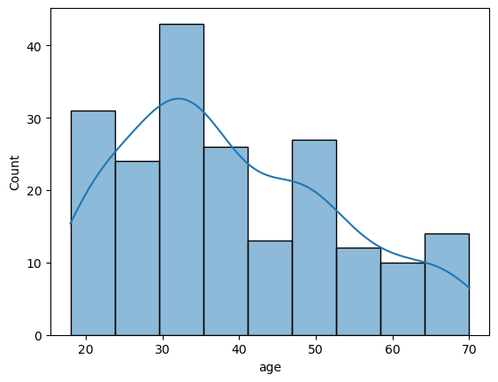
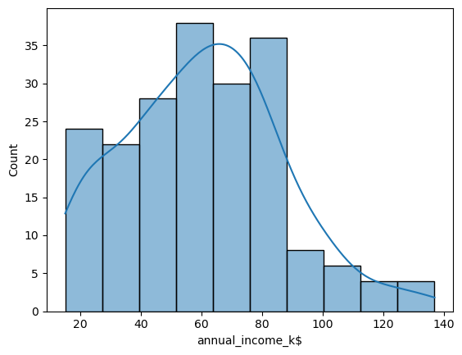
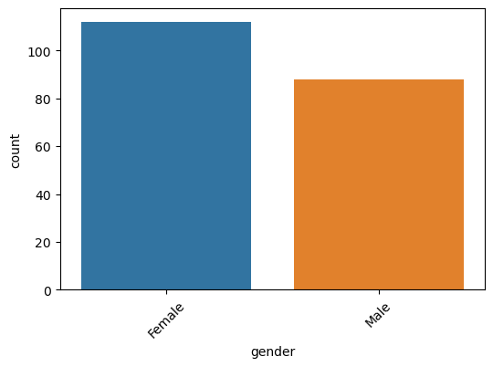
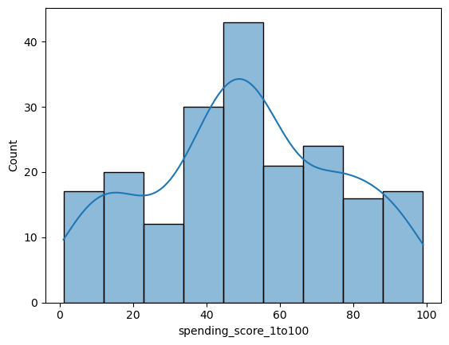
EDA: Univariate Analysis

Slide 9
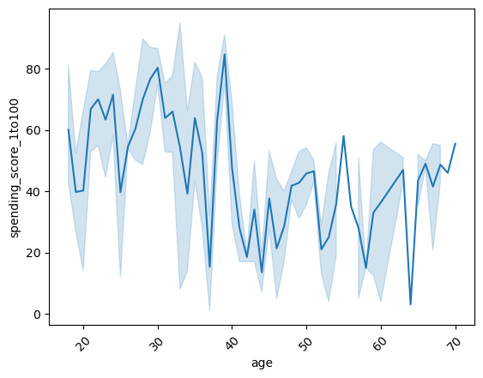
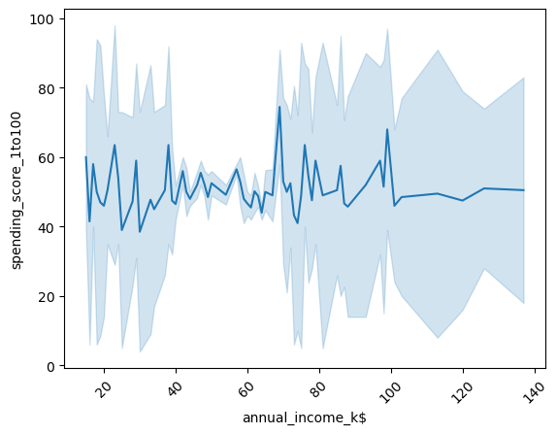
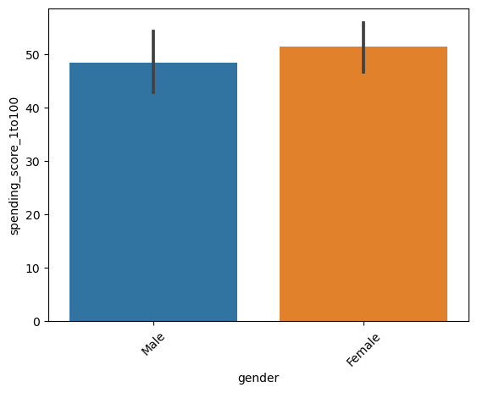
EDA: Bivariate Analysis

Slide 10
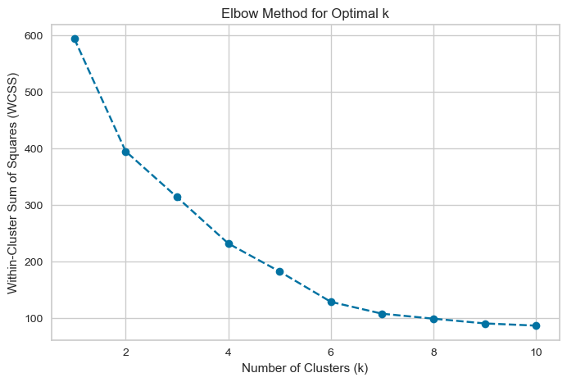
Elbow Curve

Slide 11
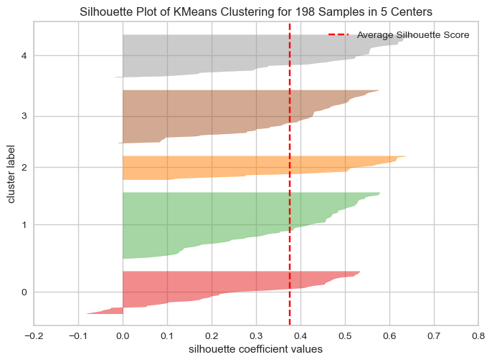
Silhouette Visualizer
Silhouette Score | Status
0.40347363457407664 | Before Scaling
-0.027438126139851204 | After Scaling
0.036646501086702525 | After treating outliers

Slide 12
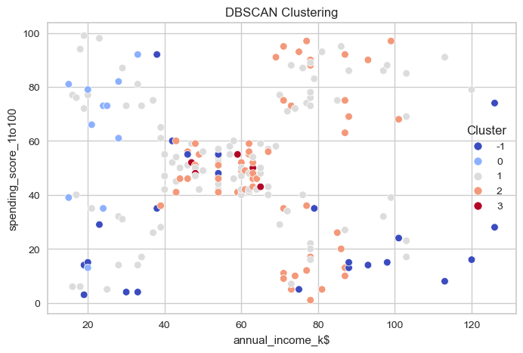
DBSCAN Clustering

Slide 13
EDA Findings
Spending behavior varies significantly across different income levels.
Some high-income customers have low spending scores, indicating cautious spending habits.
Young customers exhibit diverse spending behaviors, requiring further segmentation.

Slide 14
Algorithms Used for Clustering
K-Means Clustering: Primary algorithm for segmentation.
DBSCAN: Applied to explore density-based clustering for potential outliers.

Slide 15
Model Selection
Elbow Method suggests 5 clusters as optimal.
Silhouette Score confirms well-separated clusters.

Slide 16
Results & Insights
Luxury Shoppers: High income, high spending.
Value Shoppers: Low income, high spending.
Budget-Conscious: Low income, low spending.
Careful Spenders: High income, low spending.
Young Shoppers: Younger customers with varied spending patterns.

Slide 17
Business Recommendations
Customer Segment | Recommended Strategy
Luxury Shoppers | Exclusive membership programs, premium offerings, VIP services.
Value Shoppers | Special discounts, loyalty rewards, bundle offers.
Budget-Conscious Customers | Price-sensitive promotions, affordable product recommendations.
Careful Spenders | Upselling strategies, investment-based product offerings.
Young Shoppers | Digital marketing campaigns, influencer collaborations, trend-based promotions.

Slide 18
Conclusion
Customer segmentation using clustering enables businesses to derive valuable insights and create data-driven marketing strategies. By understanding distinct customer behaviors, companies can enhance customer experiences, optimize marketing efforts, and drive long-term profitability.

Slide 19
Thankyou

